Slide 1
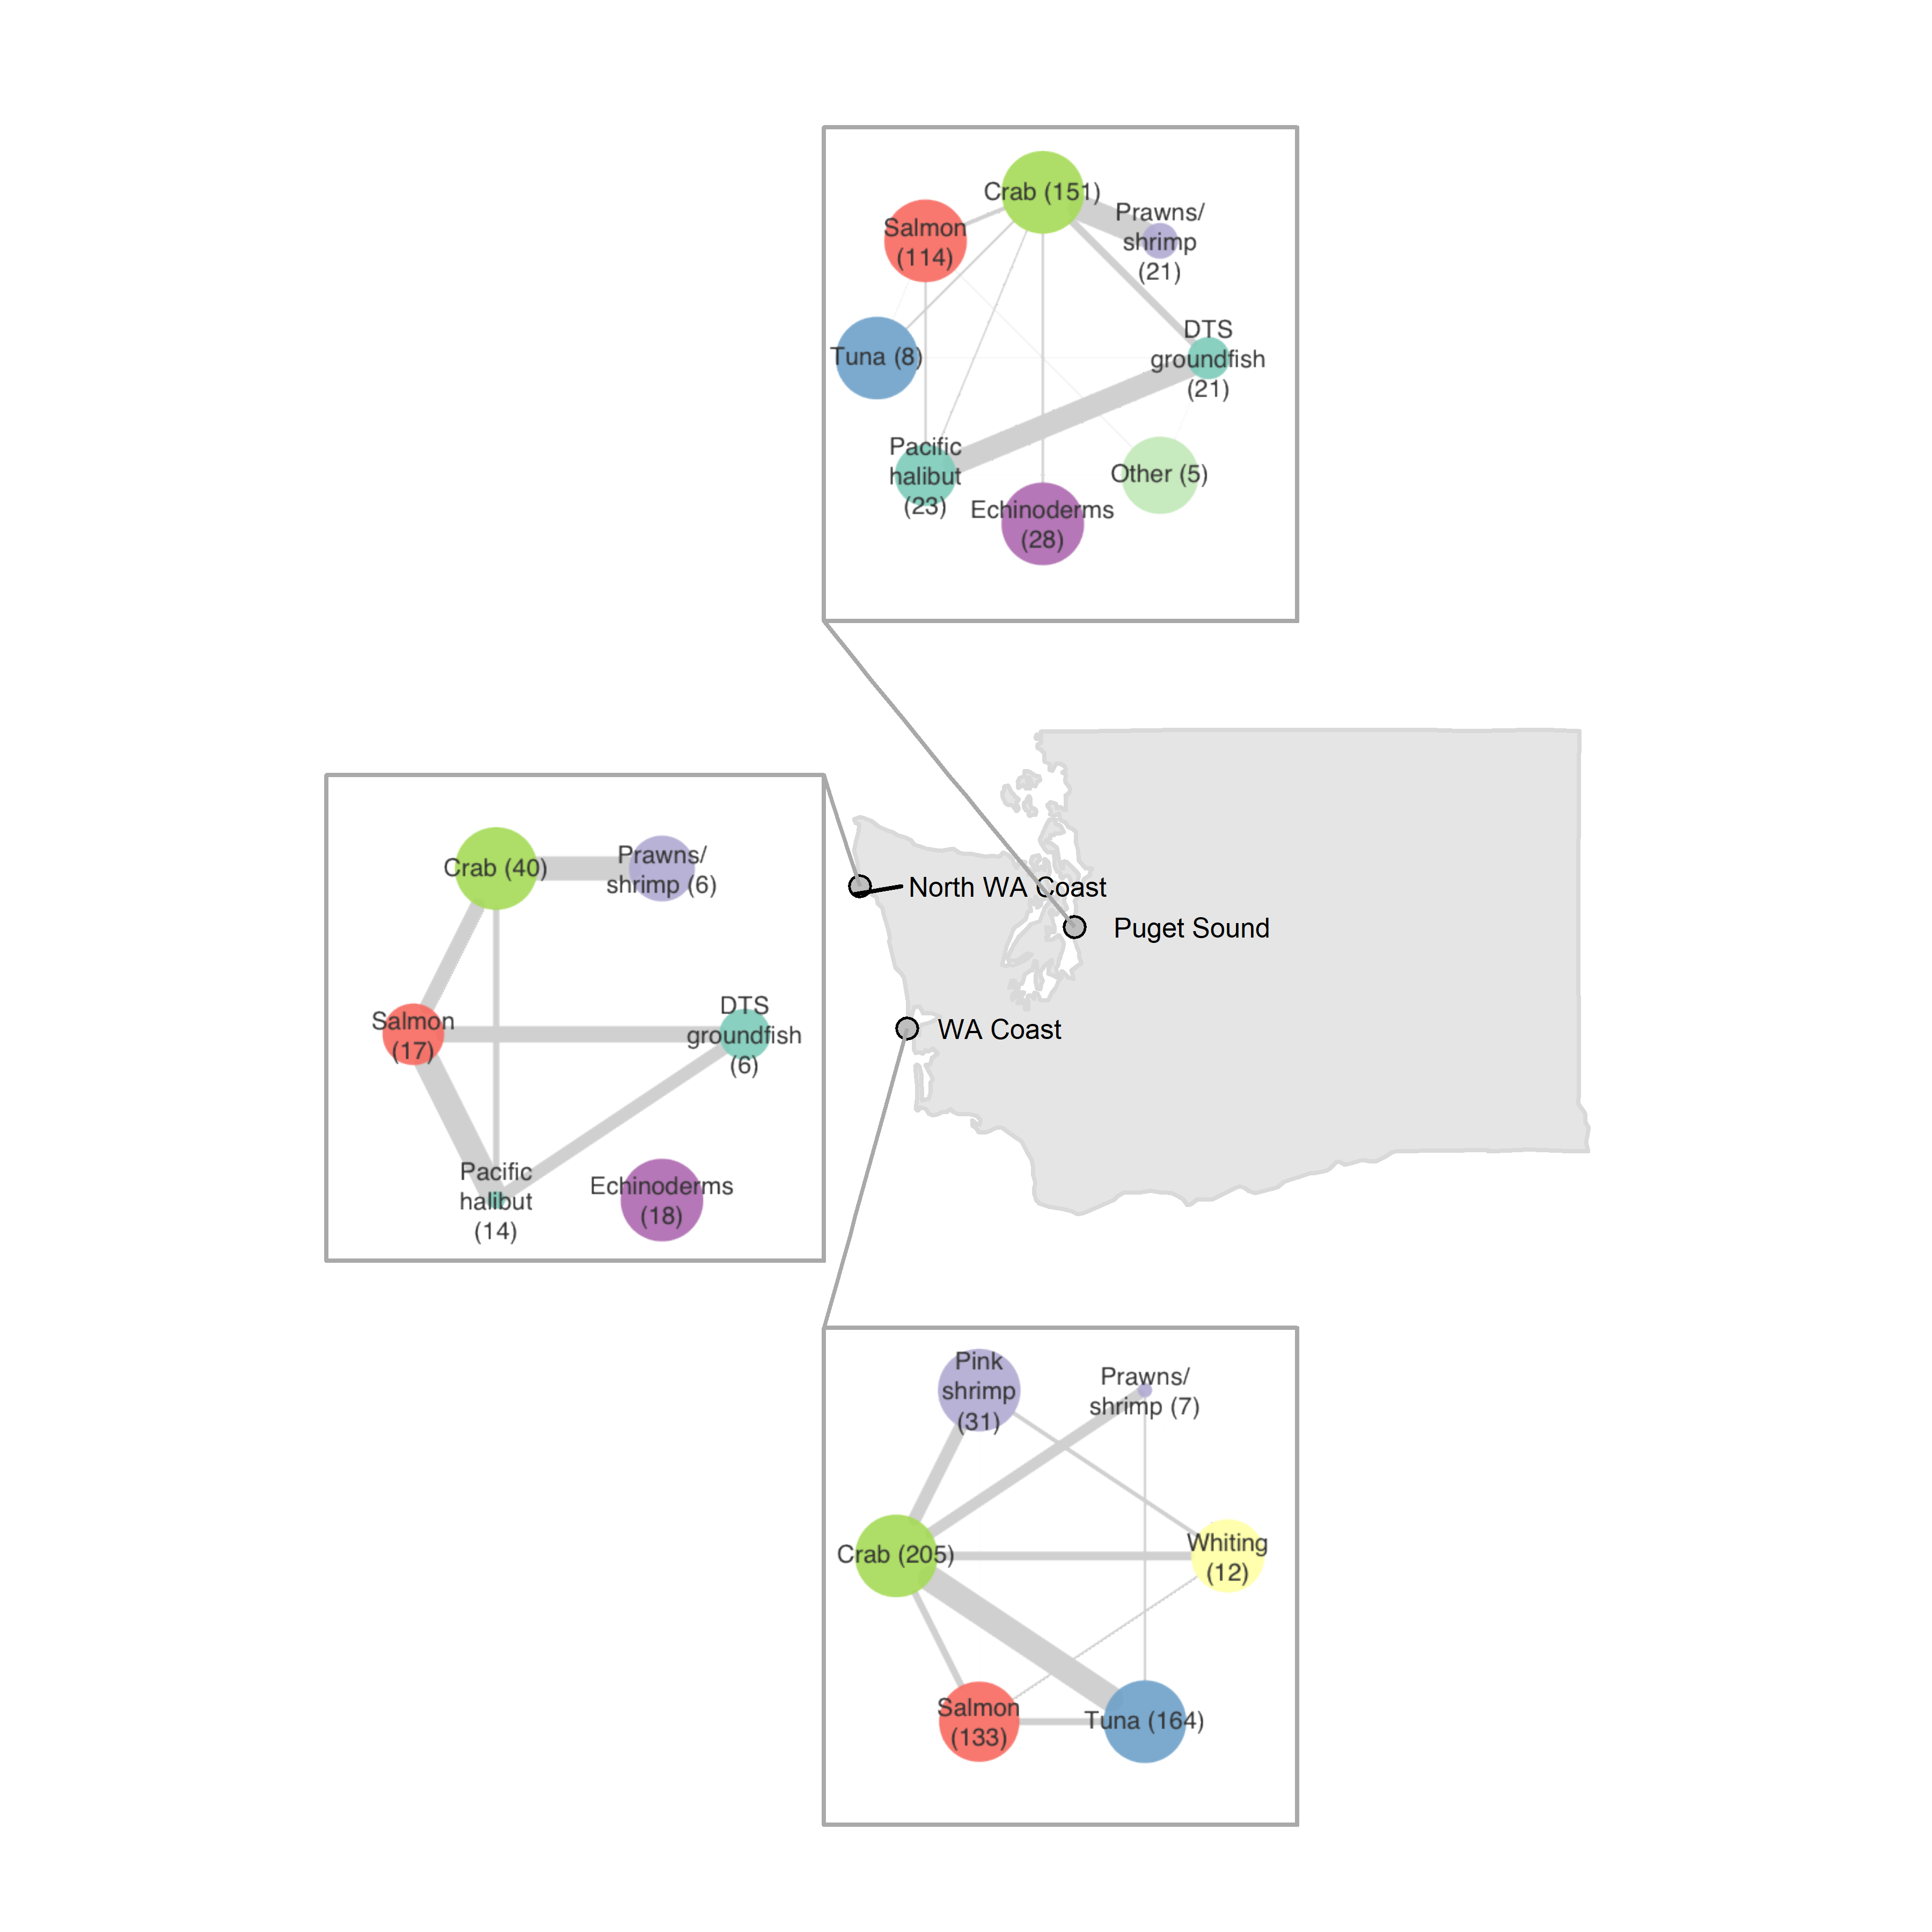
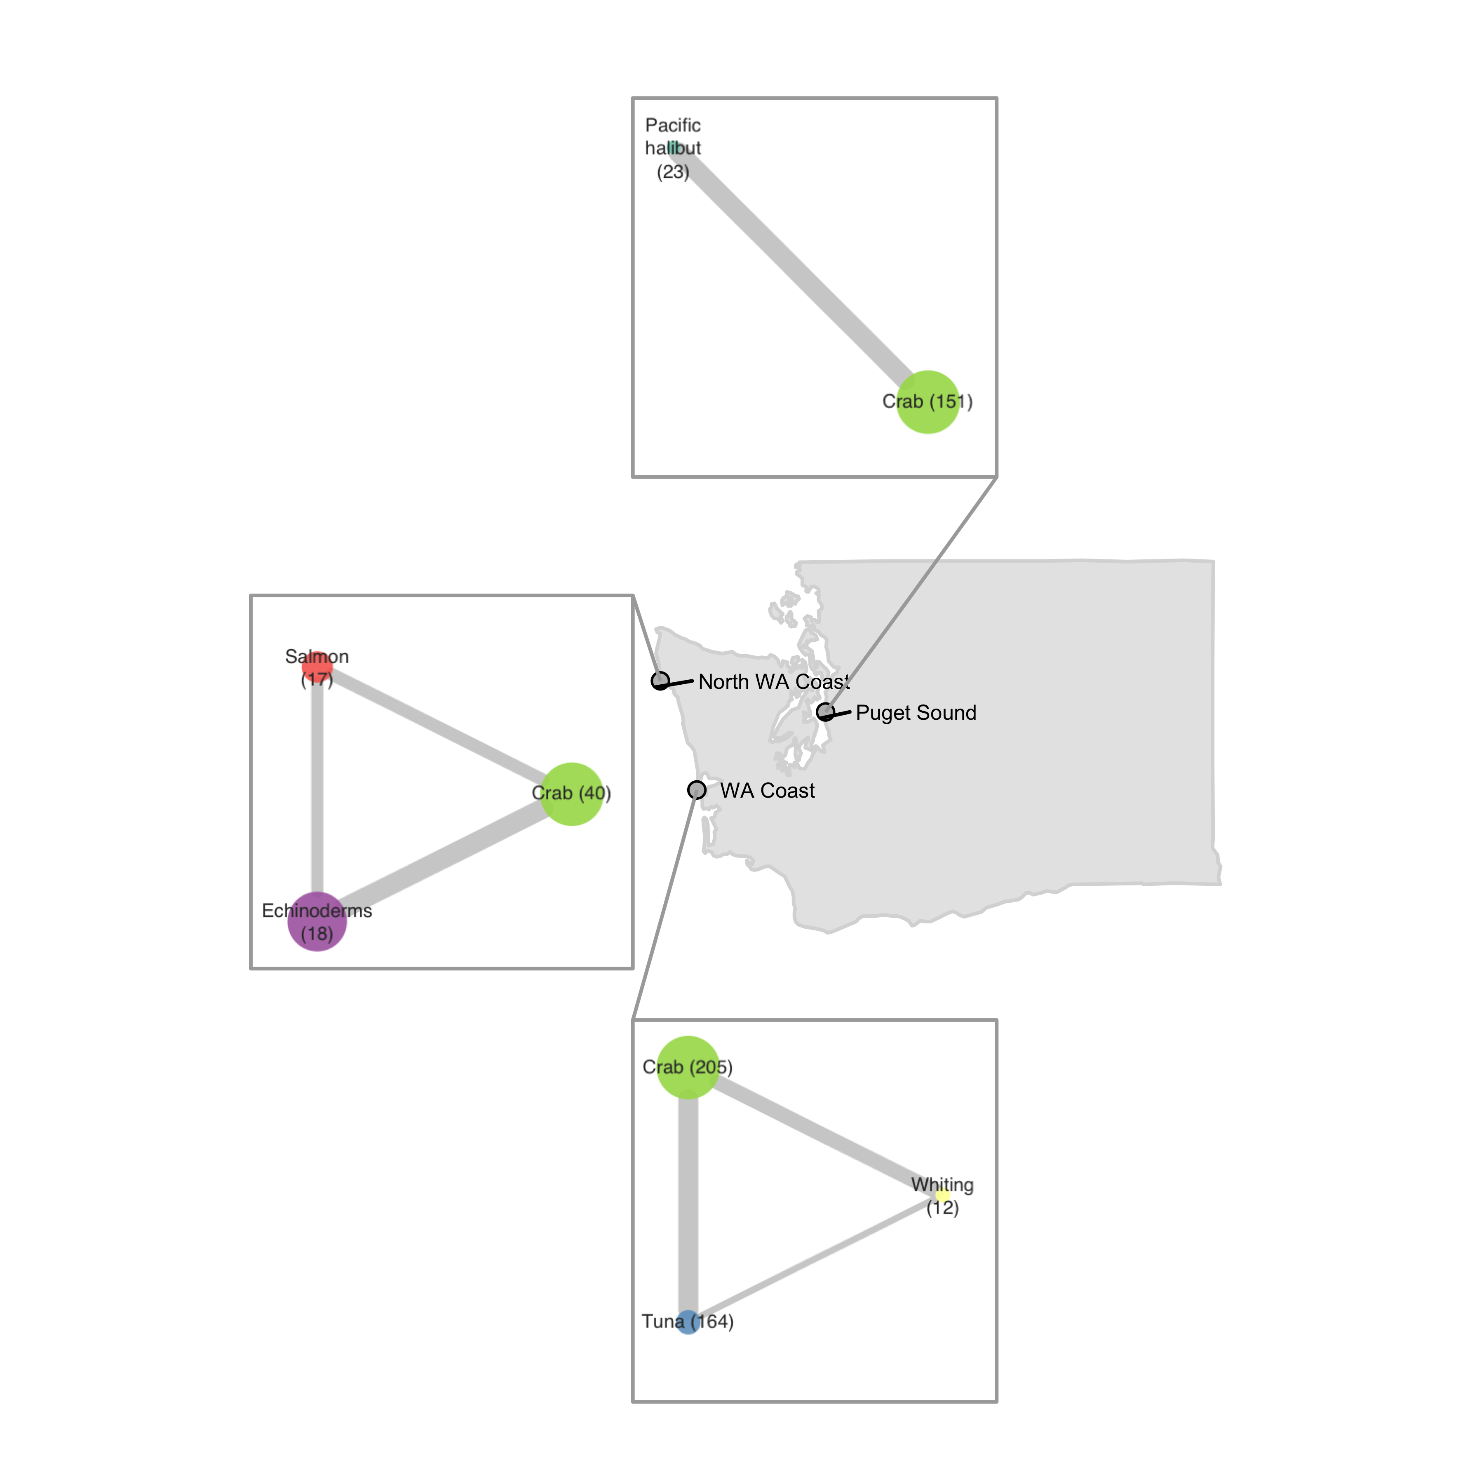
Vessel-level
includes fisheries that represent a median of 10% of vessel revenue in each port
Port-level
includes fisheries that represent at least 10% of total revenue in each port

Slide 2
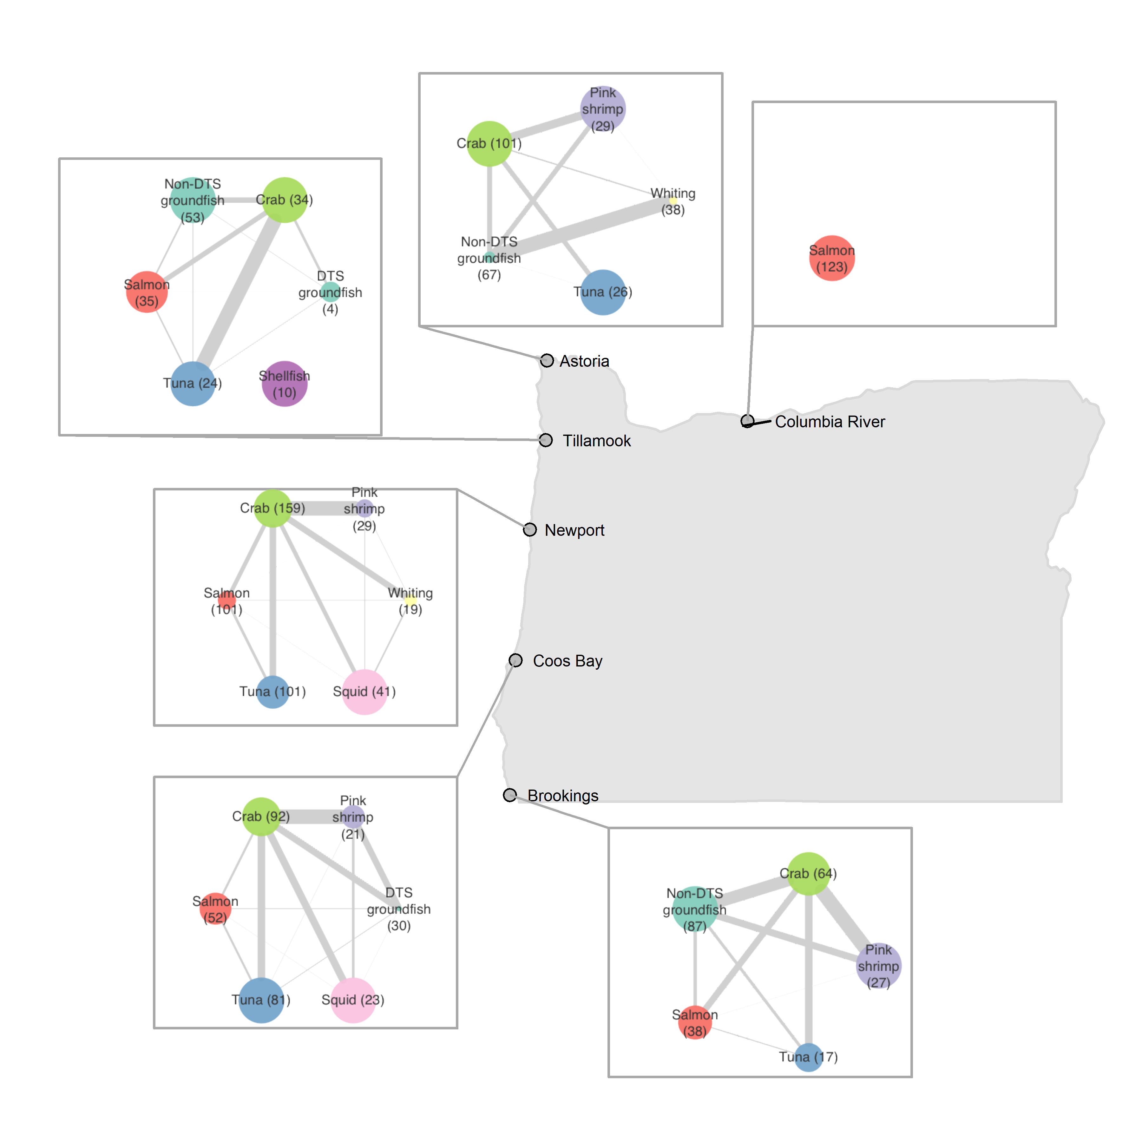
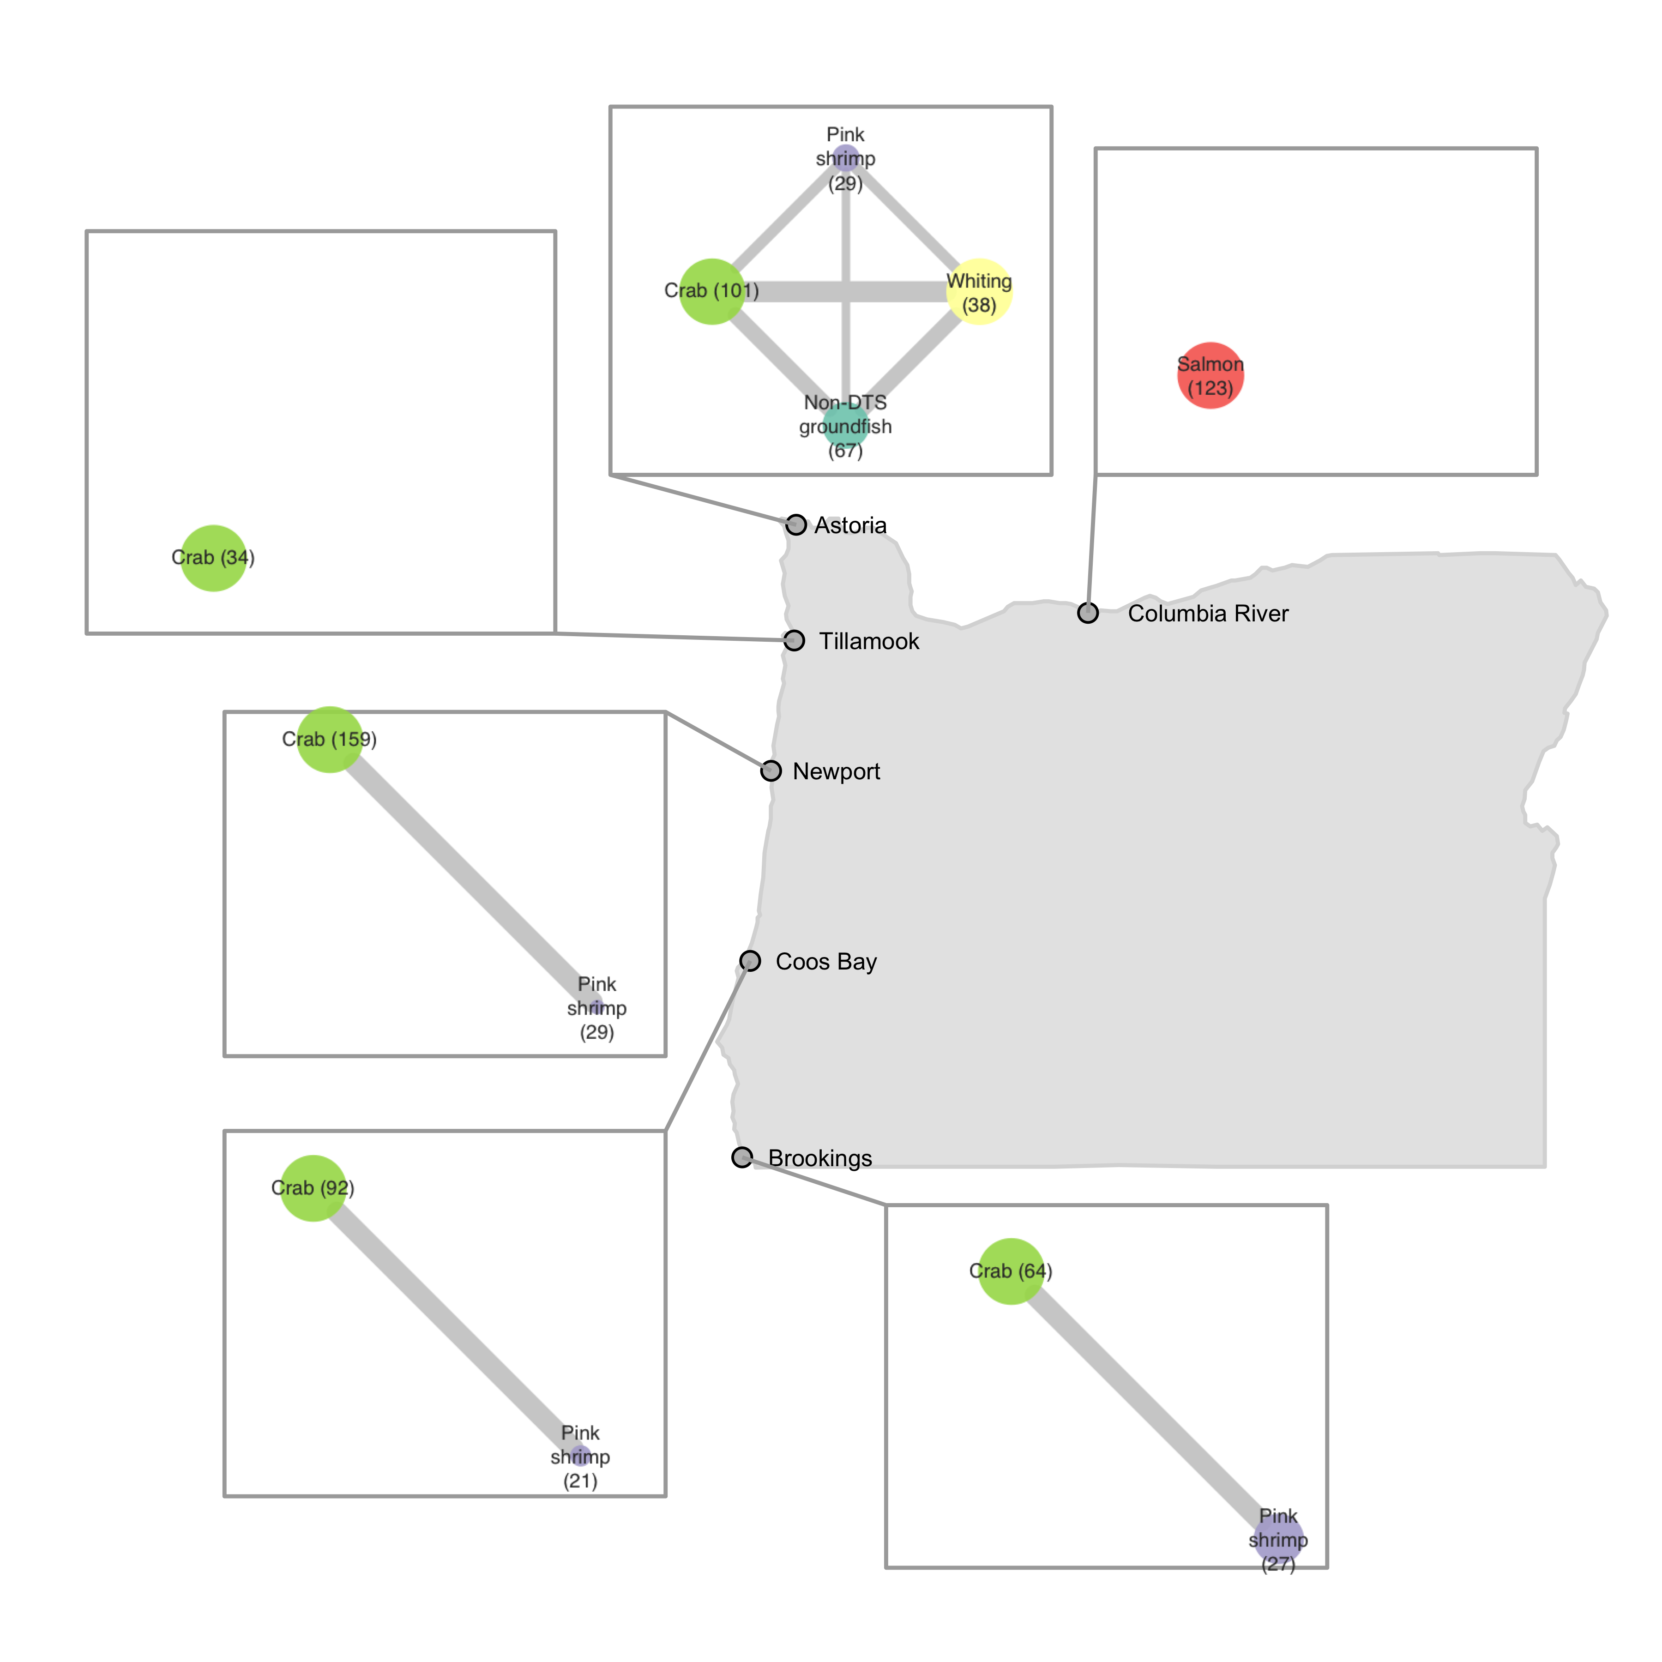
Vessel-level
includes fisheries that represent a median of 10% of vessel revenue in each port
Port-level
includes fisheries that represent at least 10% of total revenue in each port

Slide 3
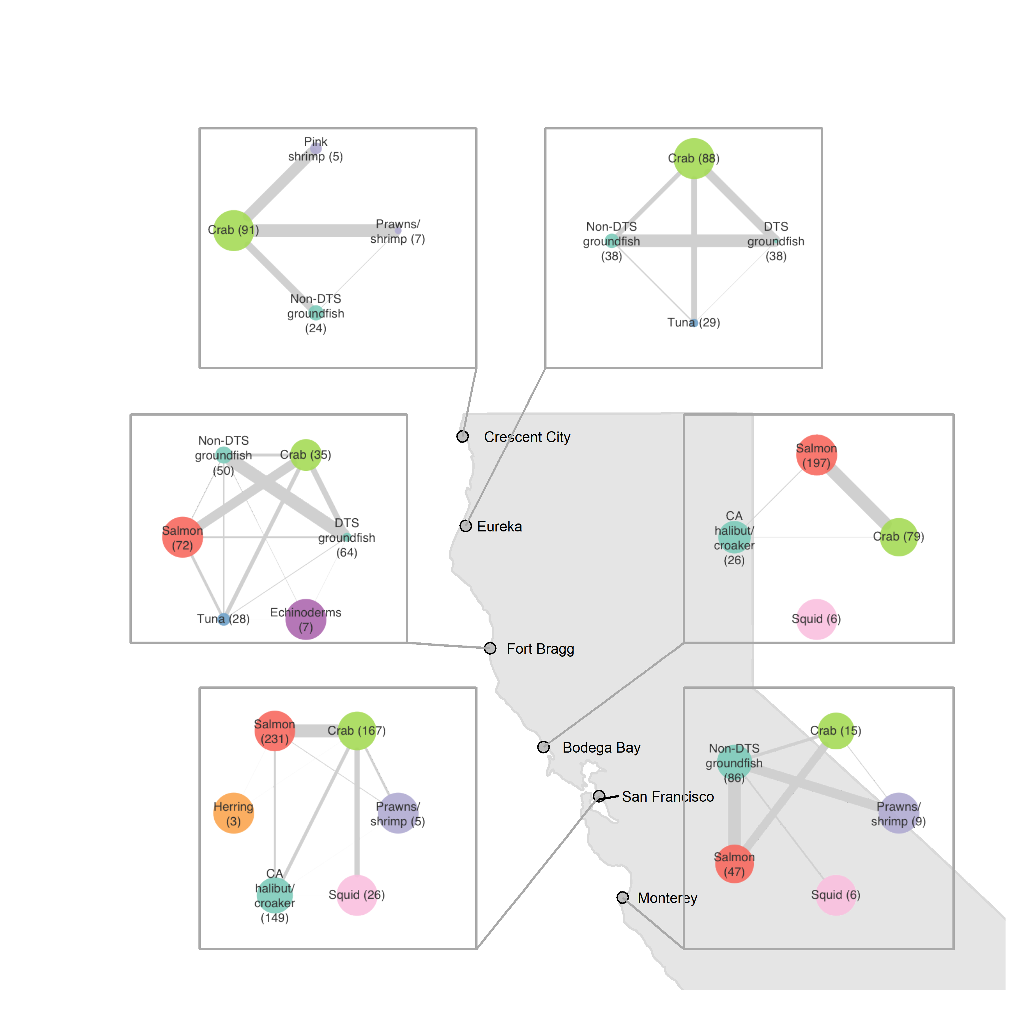
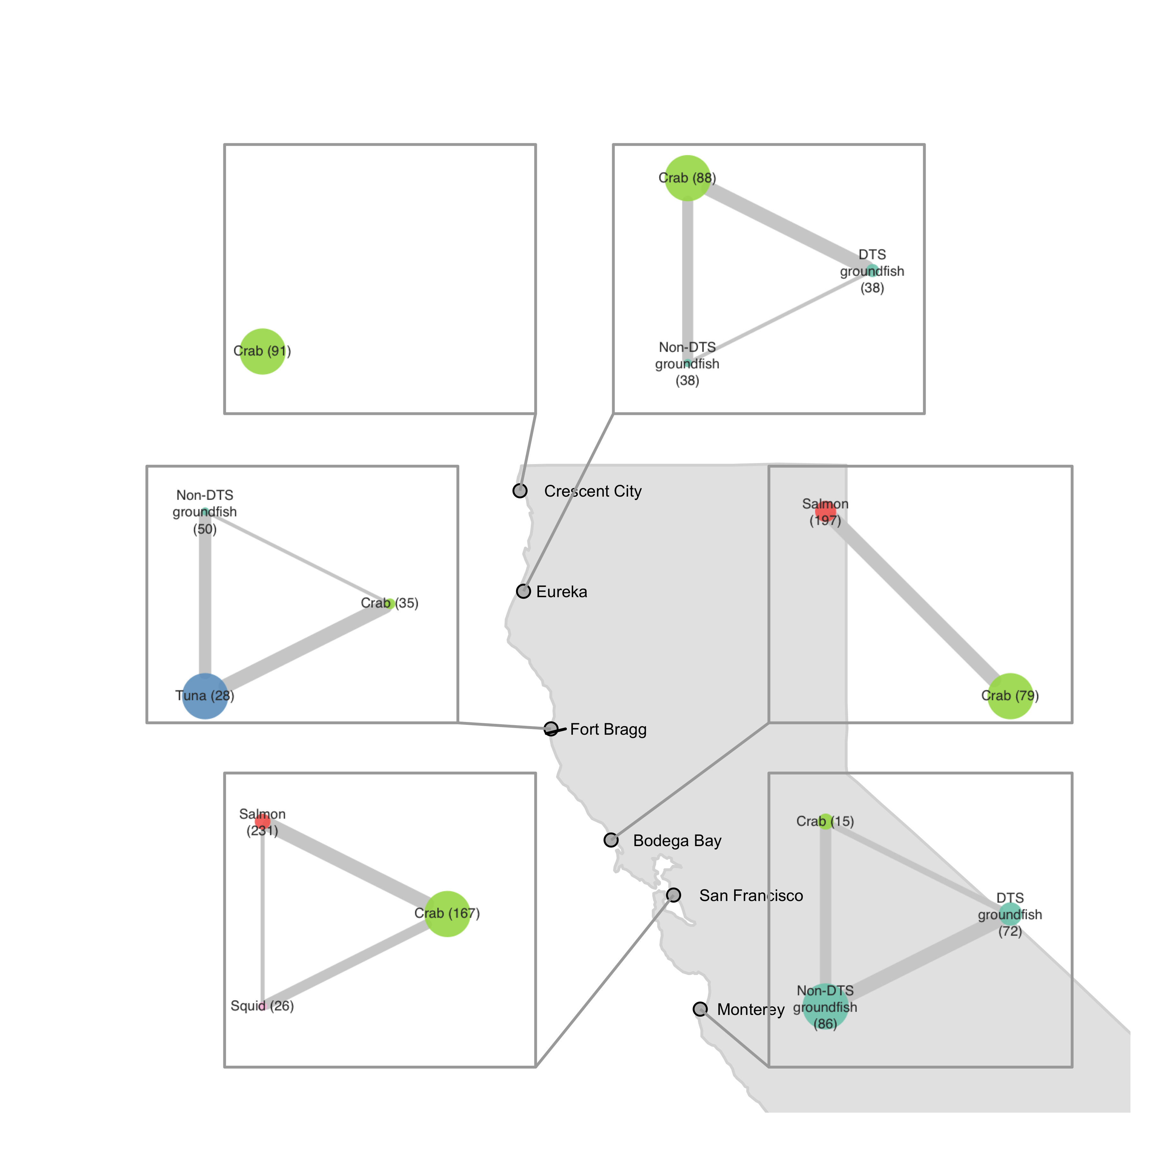
Vessel-level
includes fisheries that represent a median of 10% of vessel revenue in each port
Port-level
includes fisheries that represent at least 10% of total revenue in each port

Slide 4
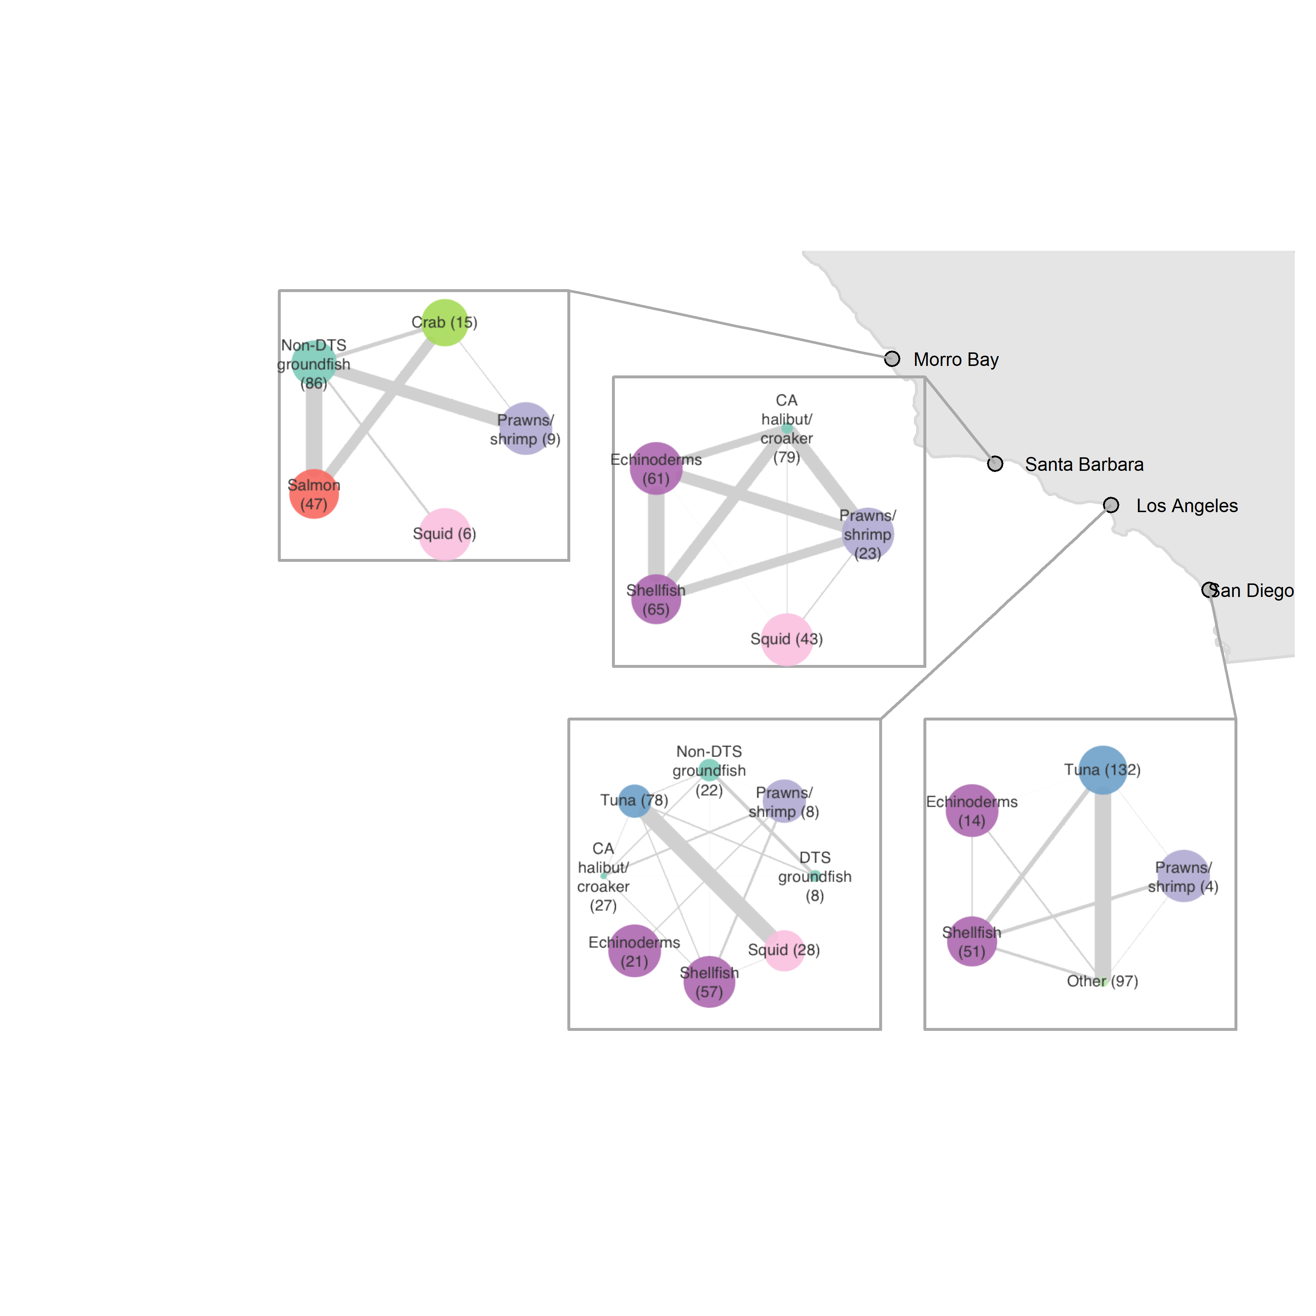
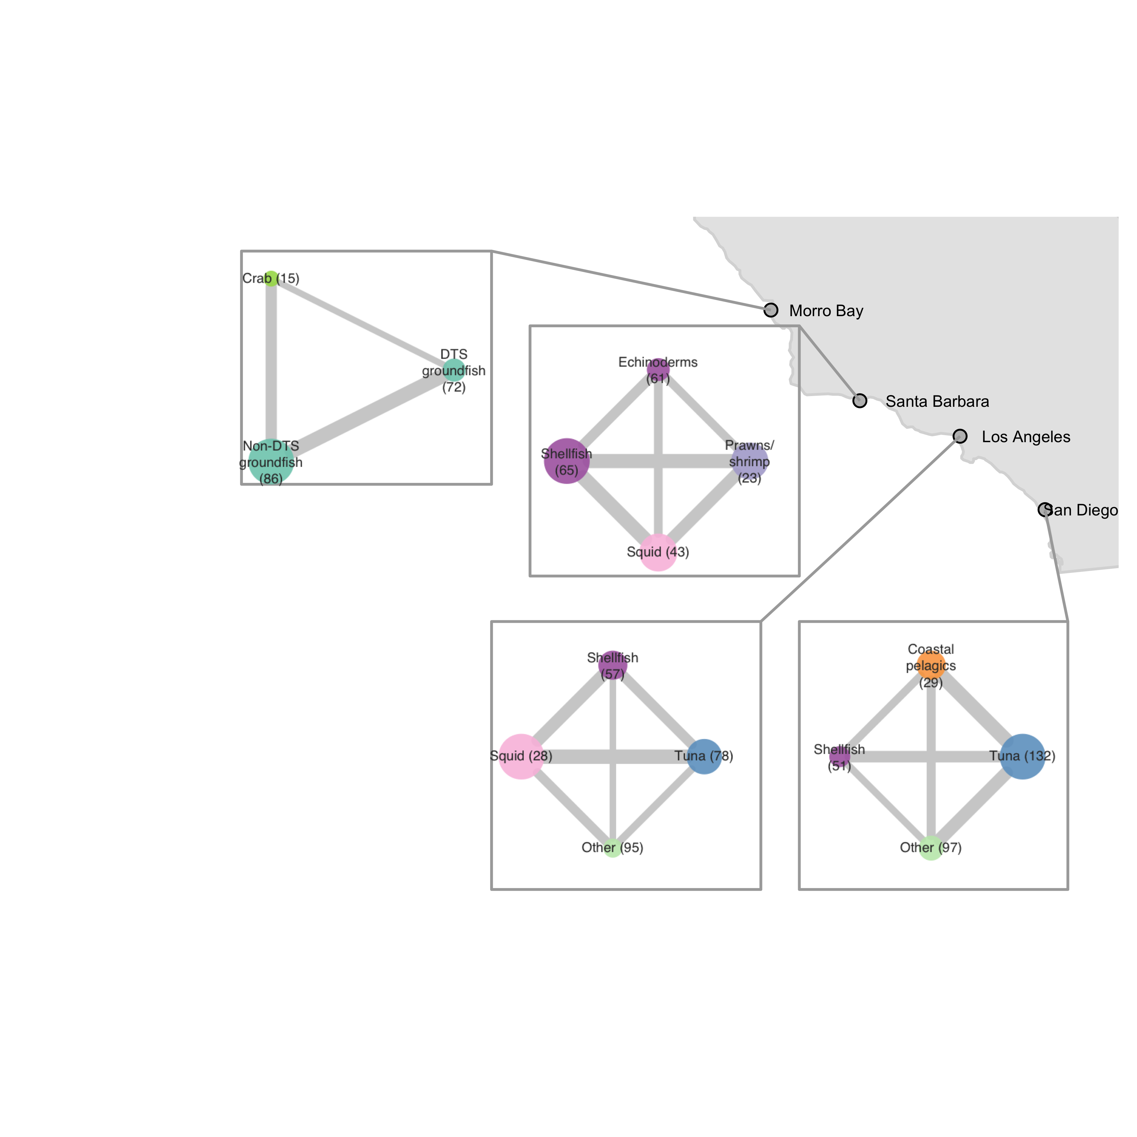
Vessel-level
includes fisheries that represent a median of 10% of vessel revenue in each port
Port-level
includes fisheries that represent at least 10% of total revenue in each port

Slide 5
5% cutoff for port-level

Slide 6
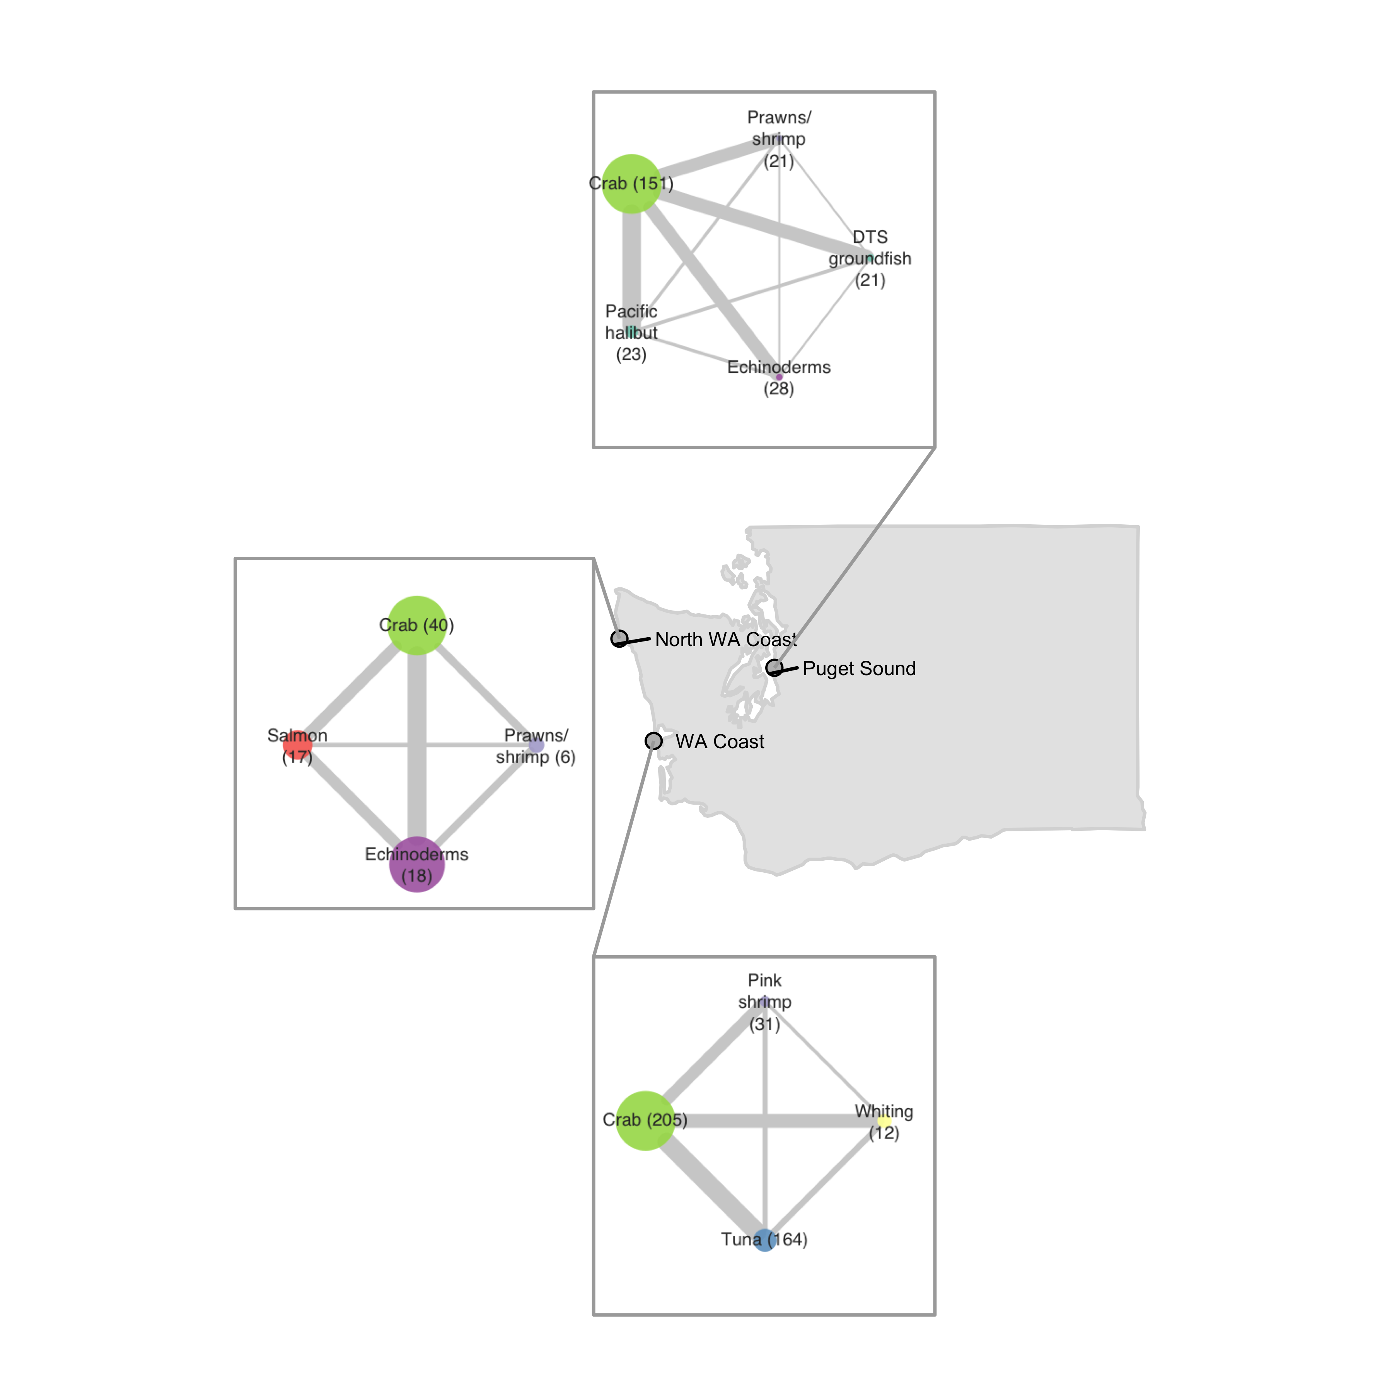
Vessel-level
includes fisheries that represent a median of 10% of vessel revenue in each port
Port-level
includes fisheries that represent at least 5% of total revenue in each port

Slide 7
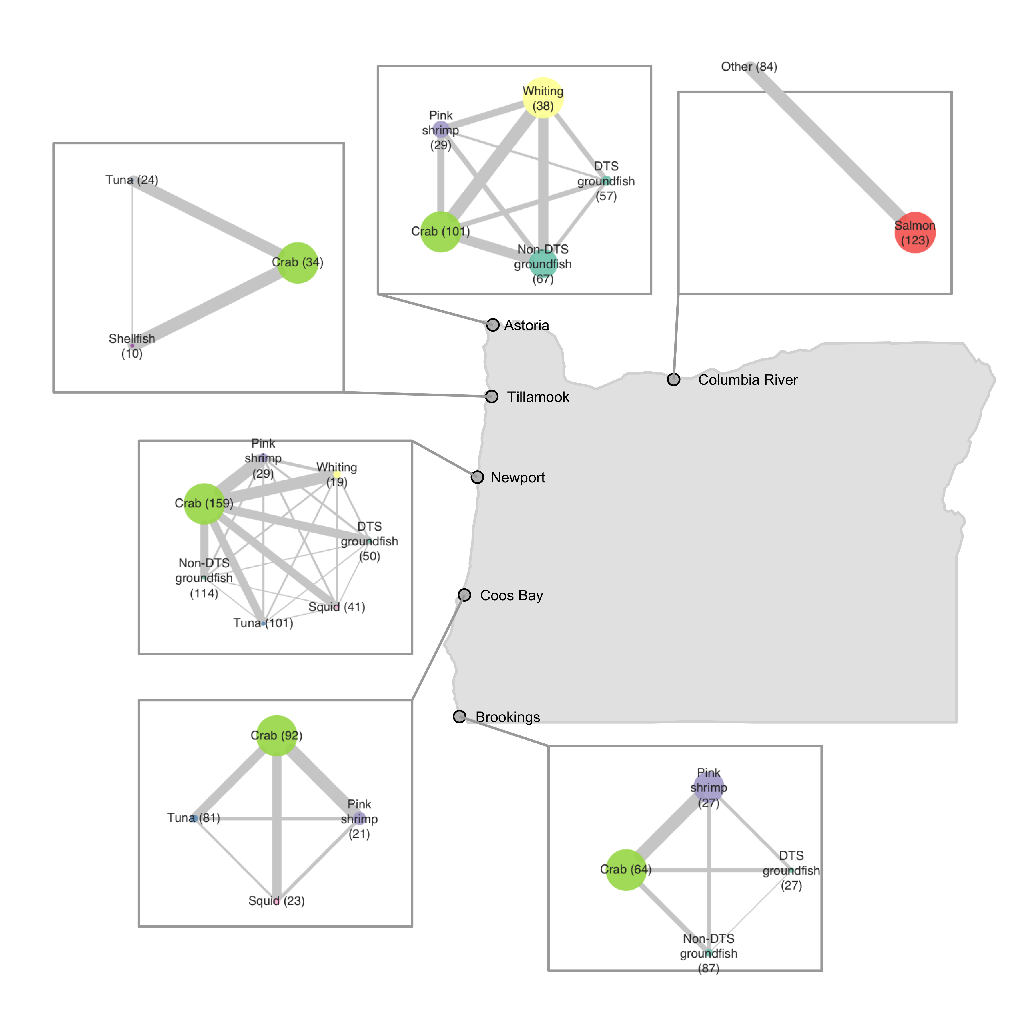
Vessel-level
includes fisheries that represent a median of 10% of vessel revenue in each port
Port-level
includes fisheries that represent at least 5% of total revenue in each port

Slide 8
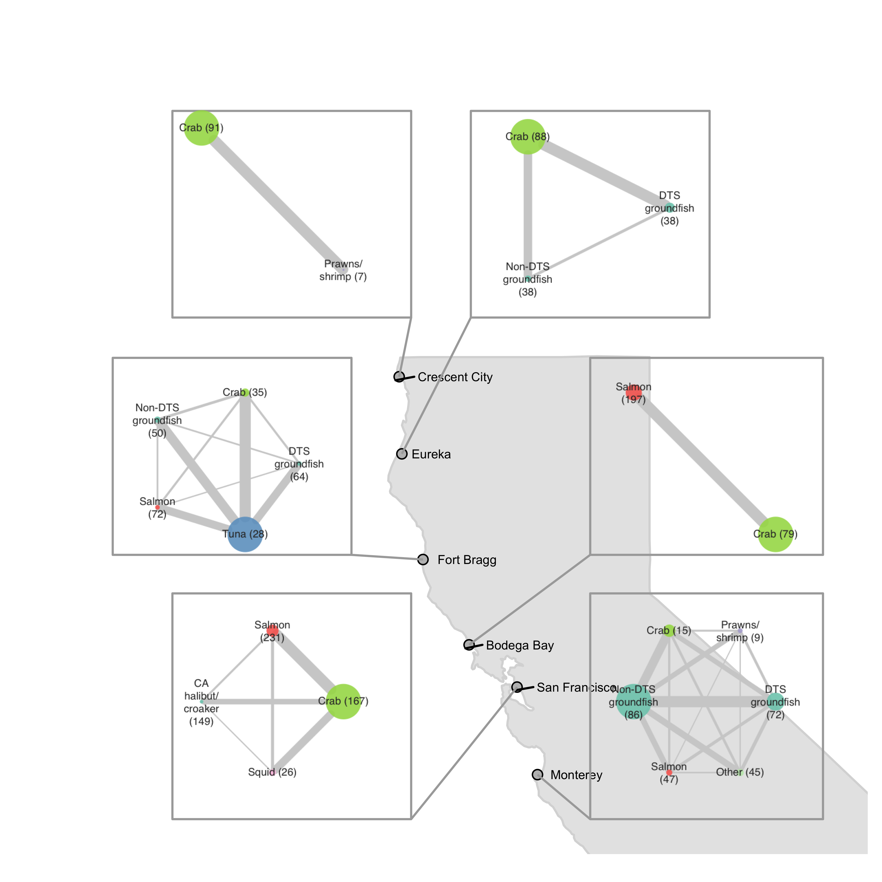
Vessel-level
includes fisheries that represent a median of 10% of vessel revenue in each port
Port-level
includes fisheries that represent at least 5% of total revenue in each port

Slide 9
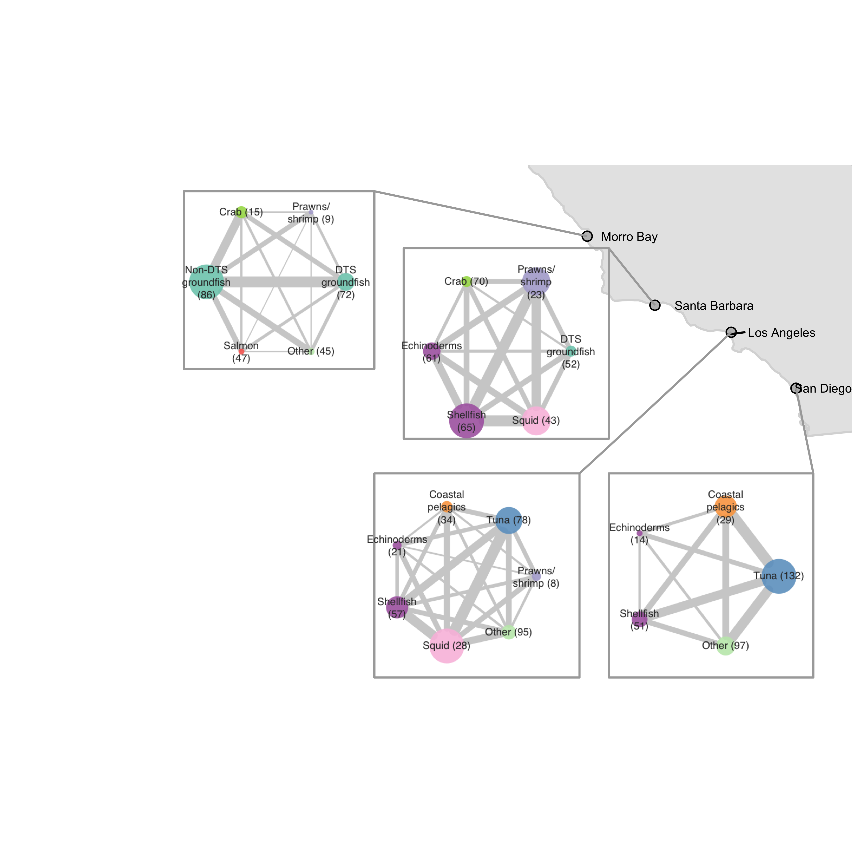
Vessel-level
includes fisheries that represent a median of 10% of vessel revenue in each port
Port-level
includes fisheries that represent at least 5% of total revenue in each port

